Slide 1
A Framework For Integrating Pedestrians into Travel Demand Models
Kelly J. Clifton
Civil Engineering Department Seminar
Monash University
July 14, 2017

Slide 2
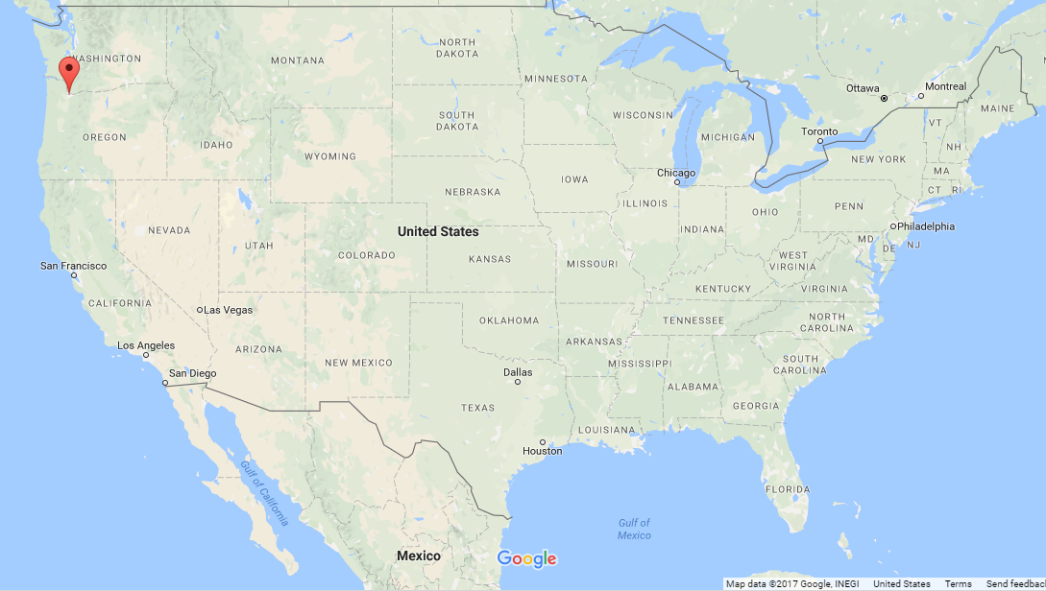
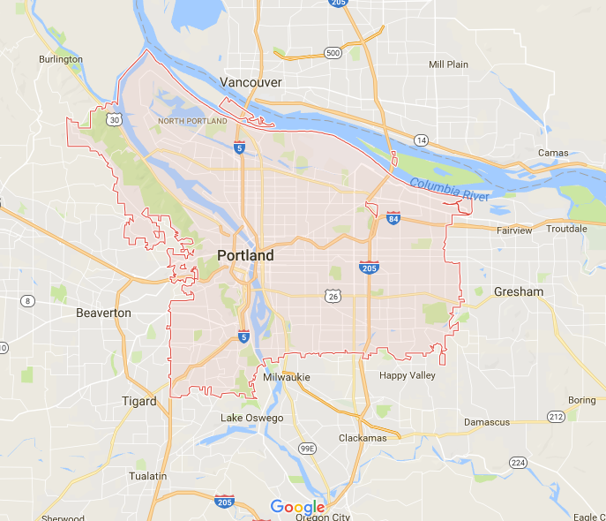

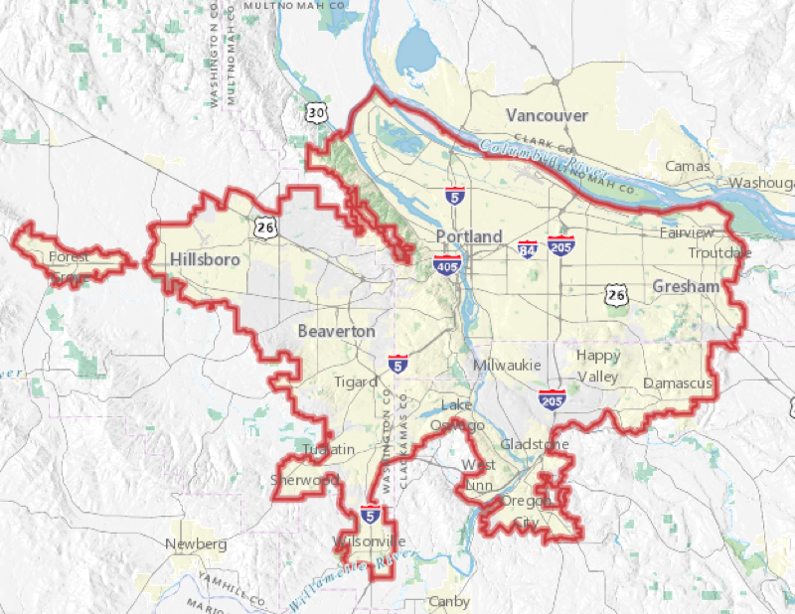
Portland, Oregon, USA
Region
Population~ 2.4 M
Urban Growth Boundary
Only elected regional government in US
City
25th largest in US
Population ~ 640k
Area ~ 376 km²
Density ~ 1,689/km²

Slide 3
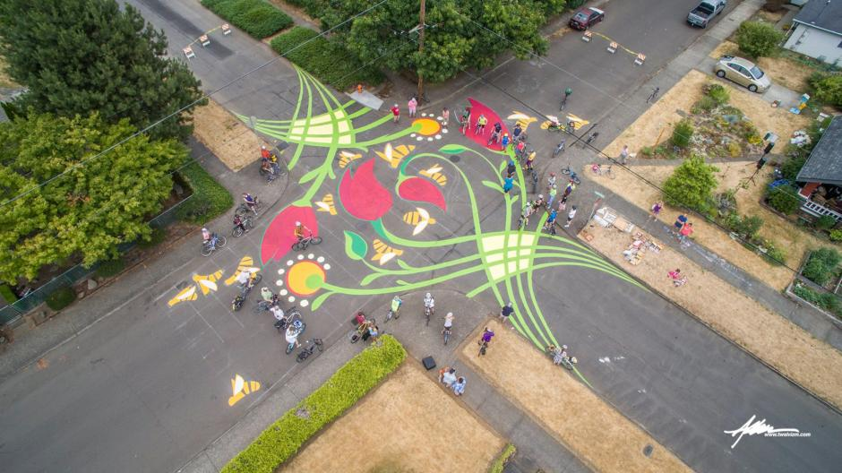
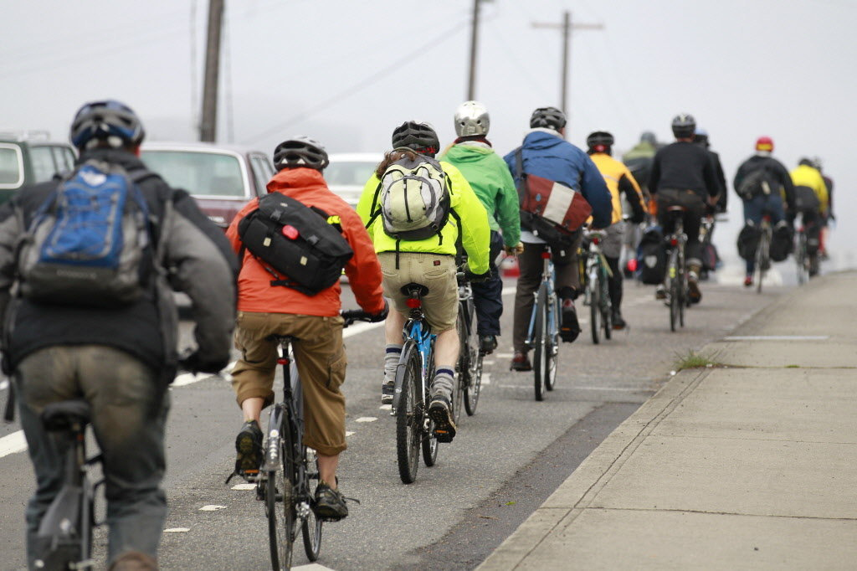

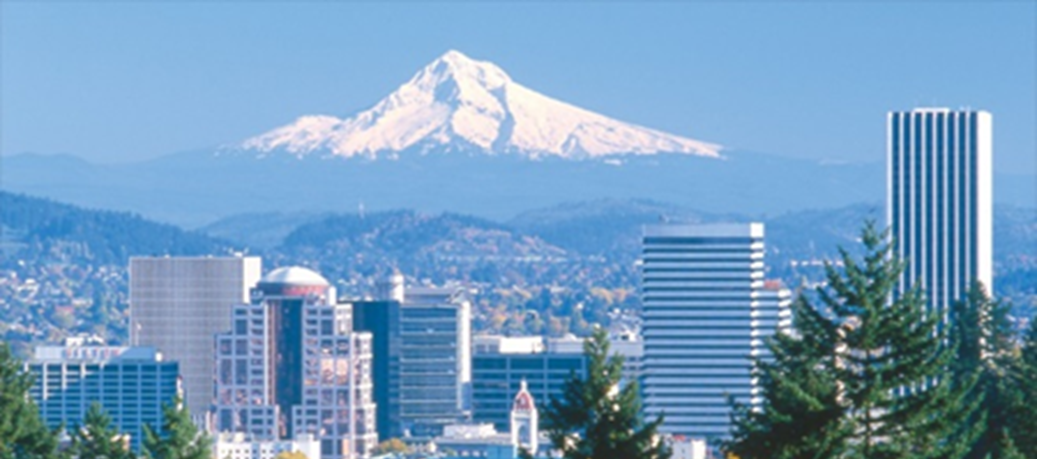


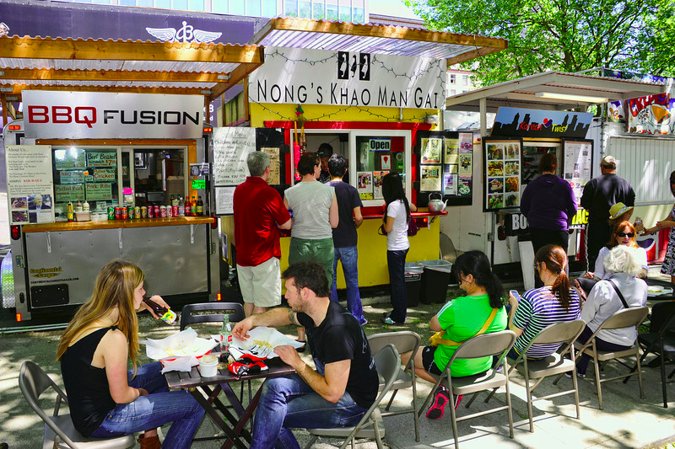
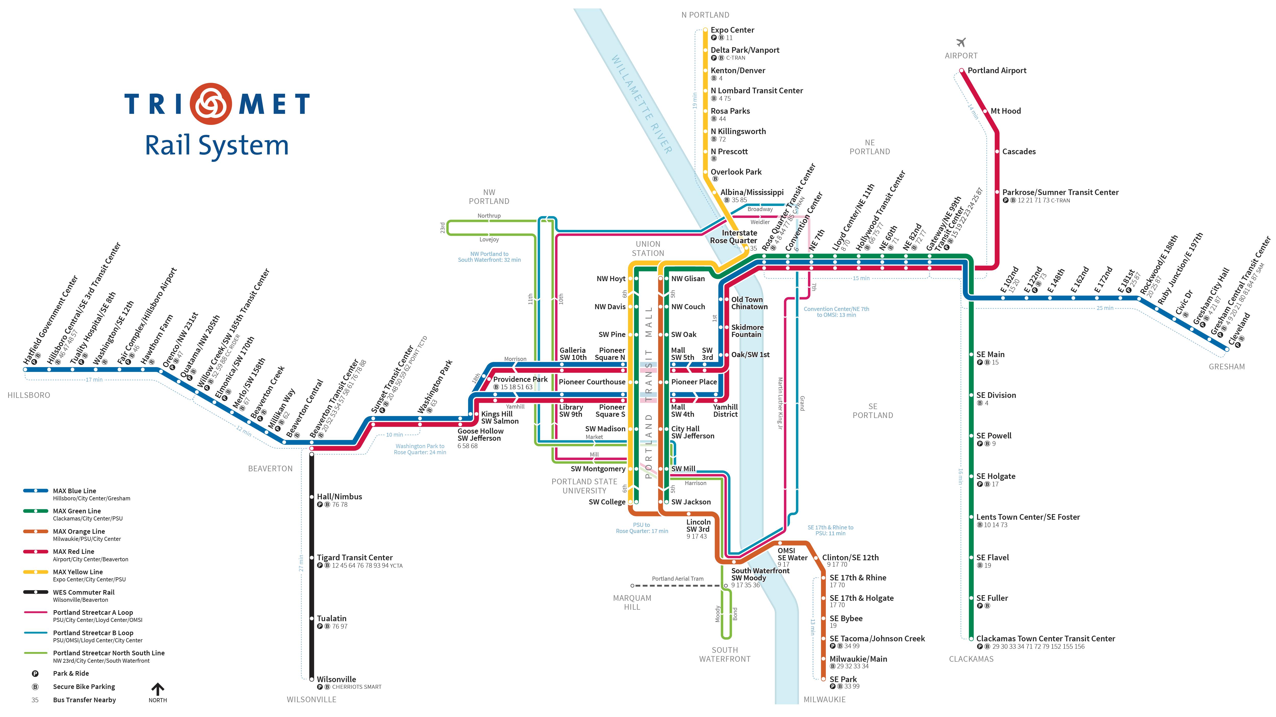

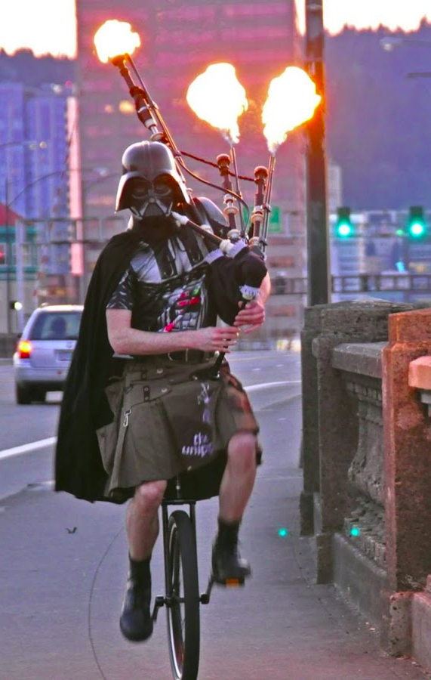
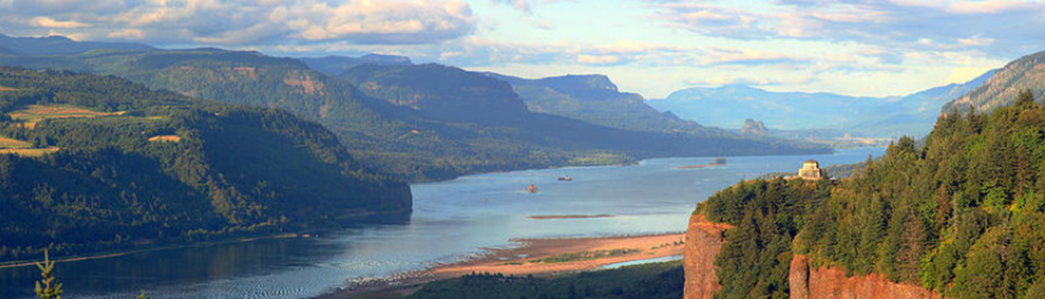
Portland, Oregon

Slide 4



Transportation @ PSU
8 transport faculty in Civil Engineering & Urban Studies & Planning
Transportation Research & Education Center (TREC) administers:
  The National Institute for Transportation & Communities, one of 5 centers funded by U.S. Department of Transportation. Focus on improving mobility of people and goods to build strong communities.
  The Initiative for Bicycle and Pedestrian Innovation, which shares active transportation insight with professionals and educators.
  TREC hosts weekly transportation seminars and offers live and archived streaming: http://trec.pdx.edu/professional-development

Slide 5
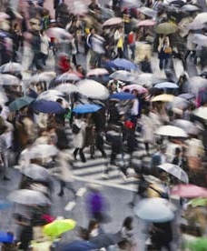
My Research Group
Travel behavior & built environment
  Residential Location
  Active travel
  Planning applications & modelling tools
  Behavioral theory
  Smart cities applications
  Equity
  Assessing transport impacts of new development
  Data collection methods
http://kellyjclifton.com

Slide 6
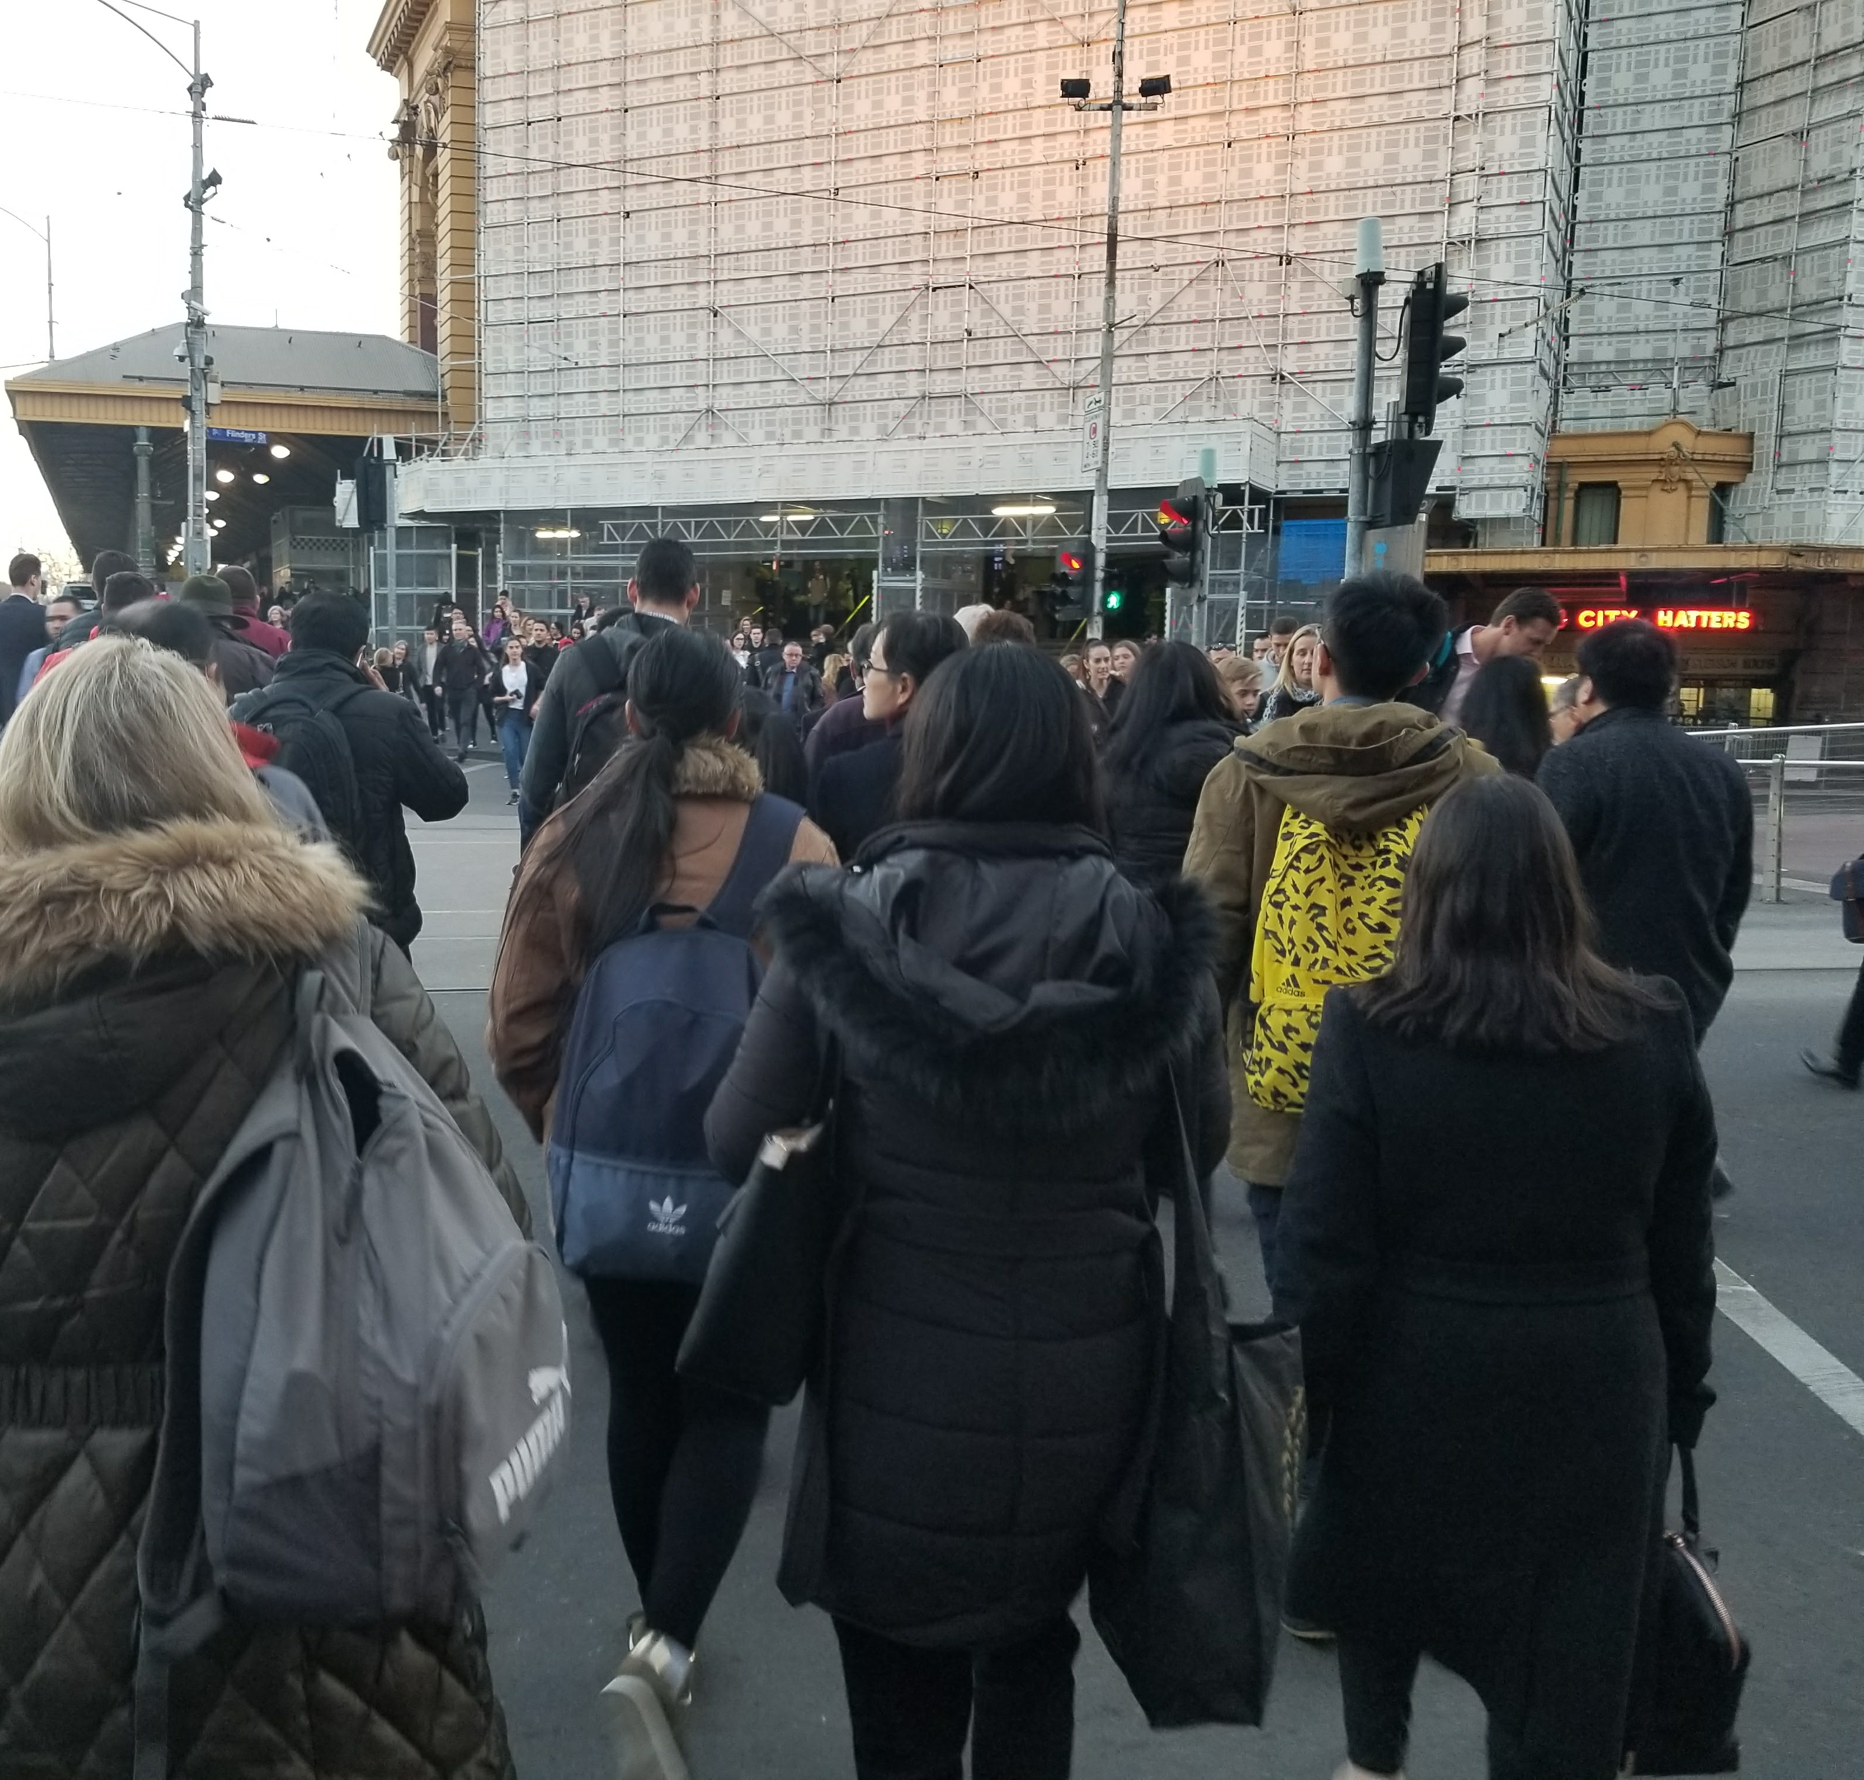
Outline
A Framework For Integrating Pedestrians into Travel Demand Models
Policy & planning context
MoPeD – Model of Pedestrian Demand
Opportunities & challenges
  Behavioral research
  Data & models
Future directions

Slide 7
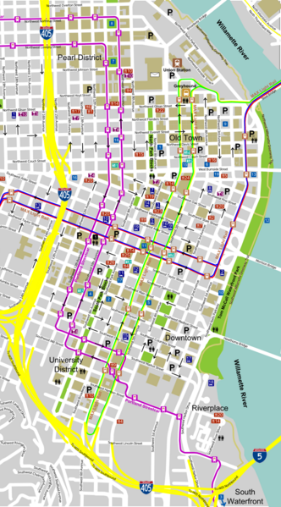
Policy & planning Context

Slide 8


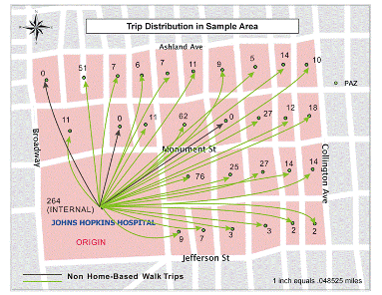



Why model pedestrians?
Pedestrian investments
Mode shifts
Greenhouse gas emissions
Health & safety
Transit access/egress
New research opportunities

Slide 9
State of the Practice
How do travel models estimate walking?
Among 48 large MPOs in US:
  38% did not estimate walking
  33% estimated non-motorized (walking + bicycling) travel
  29% estimated walking
Lacking pedestrian built environment measures & small spatial units
Trip-based model sequence
1. Generation
2. Distribution
3. Mode choice
4. Assignment
Source: Singleton, P. A., & Clifton, K. J. (2013). Pedestrians in regional travel demand forecasting models: State-of-the-practice.

Slide 10
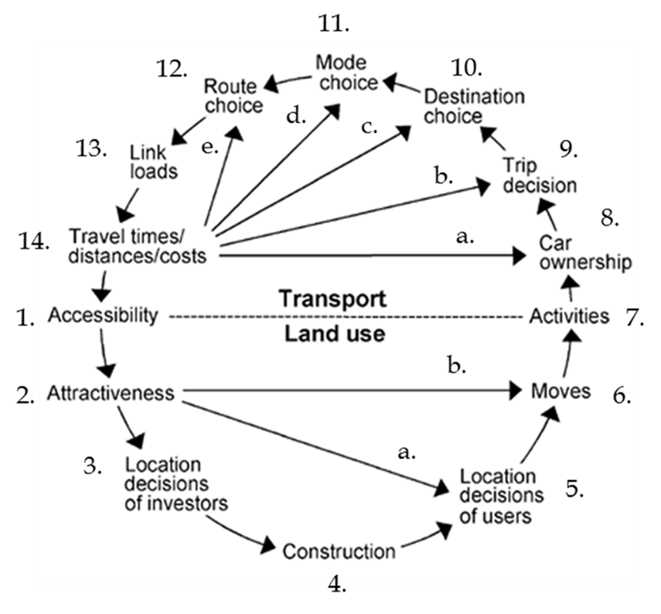
Incorporating pedestrians
Ready
Challenging
Most Challenging
Adapted from: Wegener and Fürst, 1999

Slide 11
Incorporating pedestrians
Ready
Adapted from: Wegener and Fürst, 1999

Slide 12
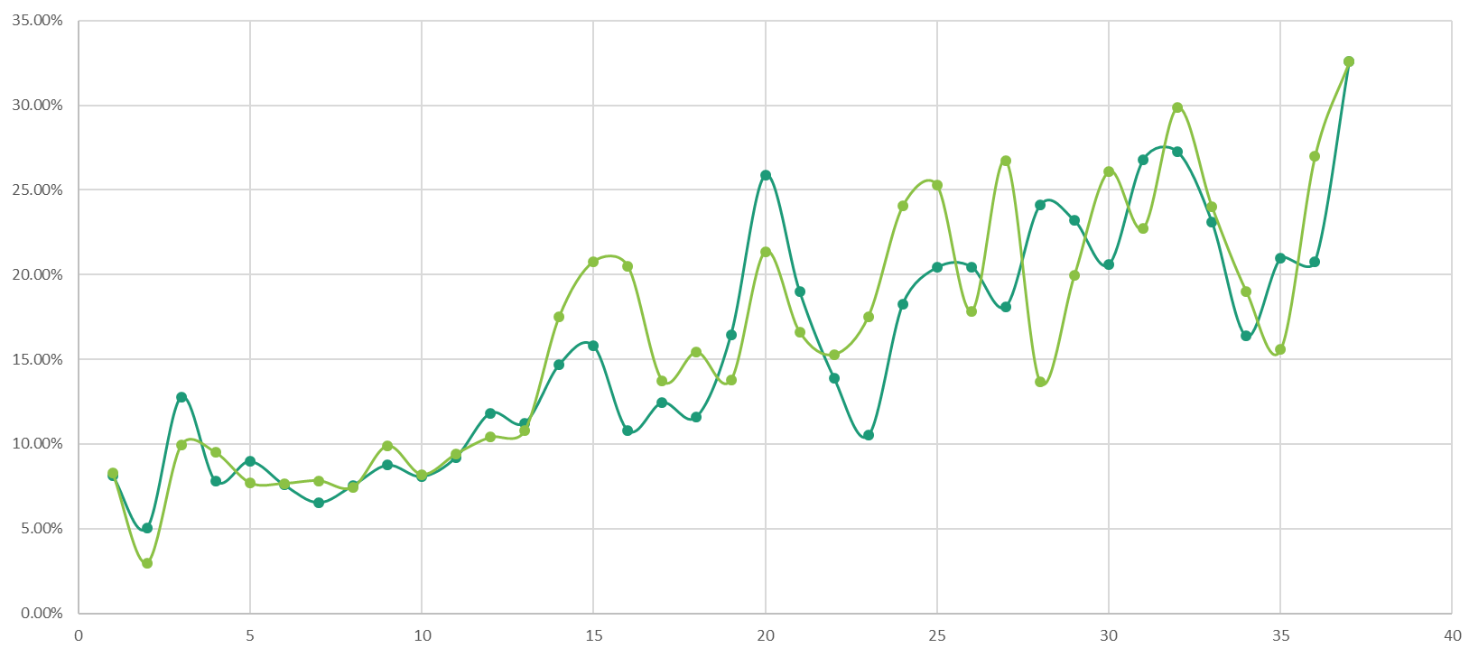
Model of Pedestrian Demand
Moped

Slide 13


Project overview
12 years of research/development in modeling pedestrian demand
Recent research projects funded by NITC and Portland Metro
  Improve representation of pedestrians in current 4-step method
  Develop stand alone tool
  Transferability & forecasting of built environment measures

Slide 14

New MoPeD method
I
Trip Generation (PAZ)
TAZ = transportation analysis zone
PAZ = pedestrian analysis zone
Walk Mode Split (PAZ)
Trip Distribution or Destination Choice (TAZ)
III
Destination Choice (PAZ)
Mode Choice (TAZ)
Pedestrian Trips
Trip Assignment
All Trips
Pedestrian Trips
Vehicular Trips

Slide 15
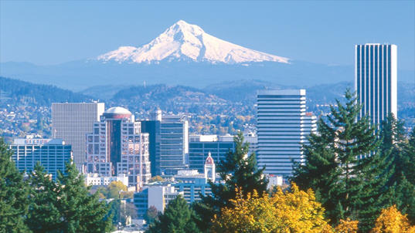
Contributions
Nests within current structure but can be used alone
Pedestrian scale analysis (PAZs)
Pedestrian-relevant variables (PIE)
One of the first studies to examine pedestrian destination choice in demand modeling framework
Highlights policy relevant
variables: distance, size,
pedestrian supports &
barriers

Slide 16

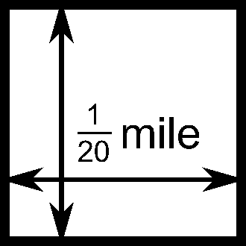
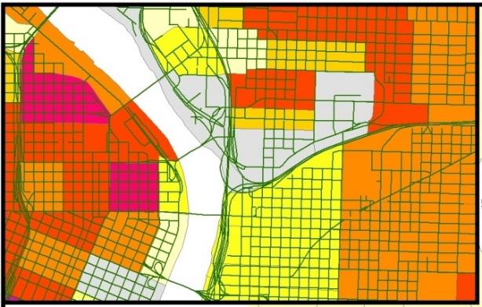
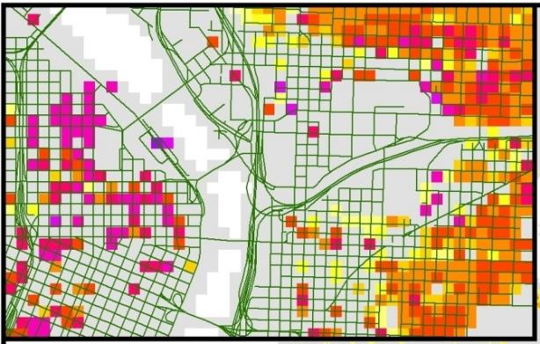
Pedestrian analysis zones
264 feet = 80 m ≈ 1 minute walk
Metro: ~2,000 TAZs → ~1.5 million PAZs
TAZs
PAZs
Home-based work trip productions

Slide 17







Pedestrian environment
Pedestrian Index of the Environment (PIE)
20–100 score = calibrated ∑(6 dimensions)
People & job density
Block size
Transit access
Sidewalk extent
Urban living infrastructure
Comfortable facilities
ULI = Urban Living Infrastructure: pedestrian-friendly shopping and service destinations used in daily life.

Slide 18
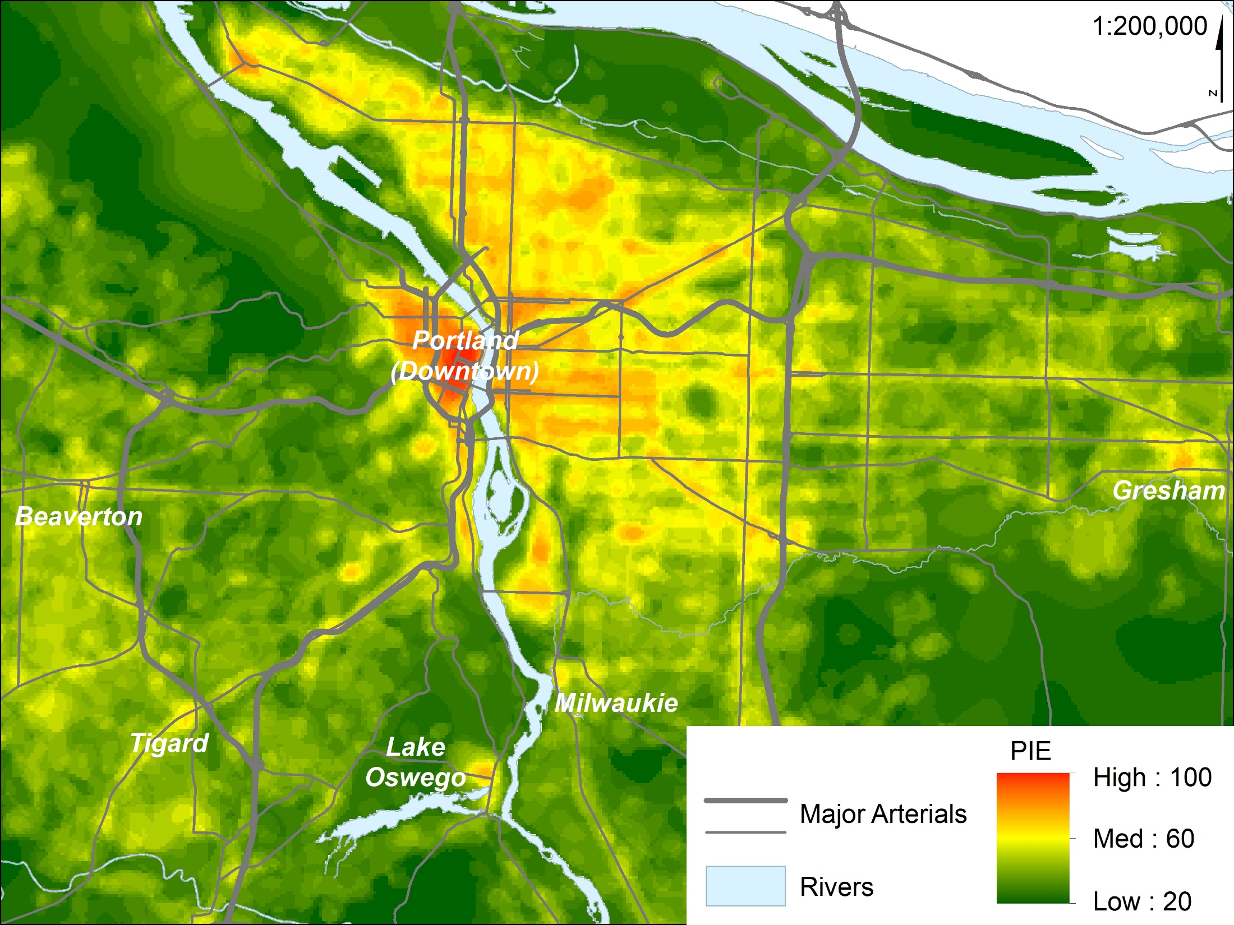

Slide 19

Trip Generation
I
Trip Generation (PAZ)
TAZ = transportation analysis zone
PAZ = pedestrian analysis zone
Walk Mode Split (PAZ)
Trip Distribution or Destination Choice (TAZ)
III
Destination Choice (PAZ)
Mode Choice (TAZ)
Pedestrian Trips
Trip Assignment
All Trips
Pedestrian Trips
Vehicular Trips

Slide 20
Trip Generation
Metro currently has 8 trip production models applied to ~2,000 TAZs:
  HBW – Home-based work;
  HBshop – Home-based shopping;
  HBrec – Home-based recreation;
  HBoth – Home-based other (excludes school and college);
  NHBW – Non-home-based work;
  NHBNW – Non-home-based non-work;
  HBcoll – Home-based college; and
  HBsch – Home-based school.
After testing for scalability, we applied the same models to our pedestrian scale ~1.5M PAZs

Slide 21
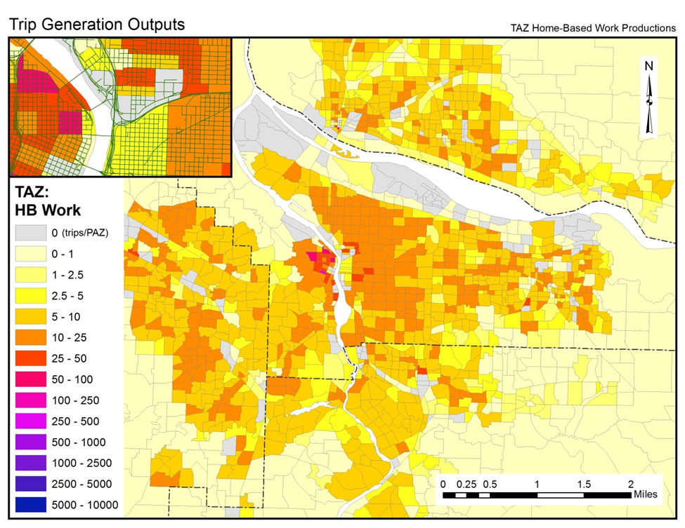
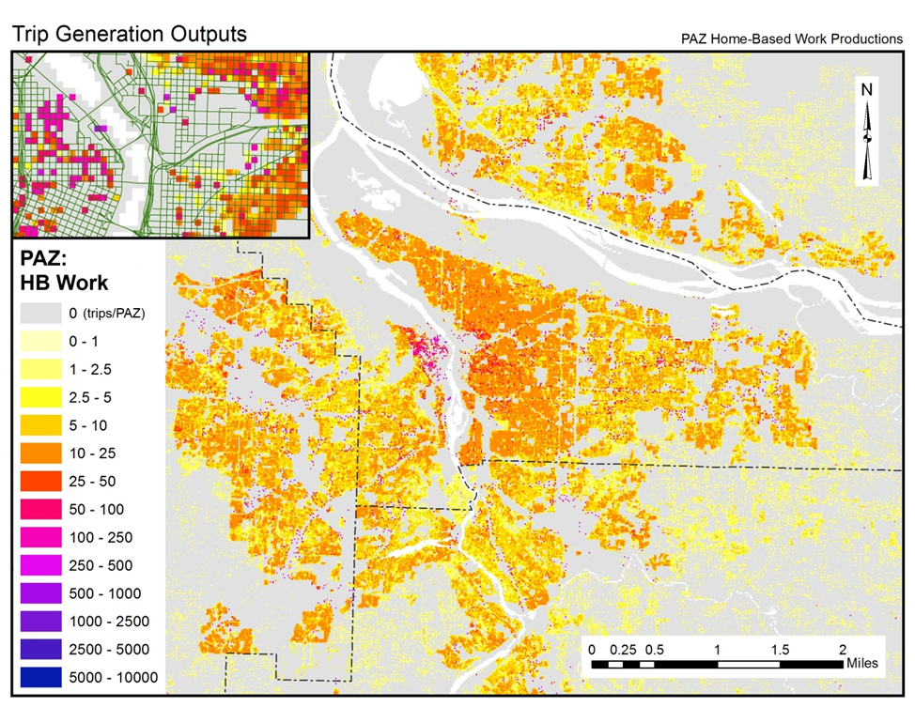

Slide 22

Walk mode split
I
Trip Generation (PAZ)
TAZ = transportation analysis zone
PAZ = pedestrian analysis zone
Walk Mode Split (PAZ)
Trip Distribution or Destination Choice (TAZ)
III
Destination Choice (PAZ)
Mode Choice (TAZ)
Pedestrian Trips
Trip Assignment
All Trips
Pedestrian Trips
Vehicular Trips

Slide 23
Walk mode split
II
Prob(walk) = f(traveler characteristics, PIE)
Data: 2011 OHAS, Production trip ends,
            90% sample
Method: binary logit model
Spatial unit: pedestrian analysis zone (PAZ)
Walk Mode Split (PAZ)
Vehicular Trips
Pedestrian Trips

Slide 24
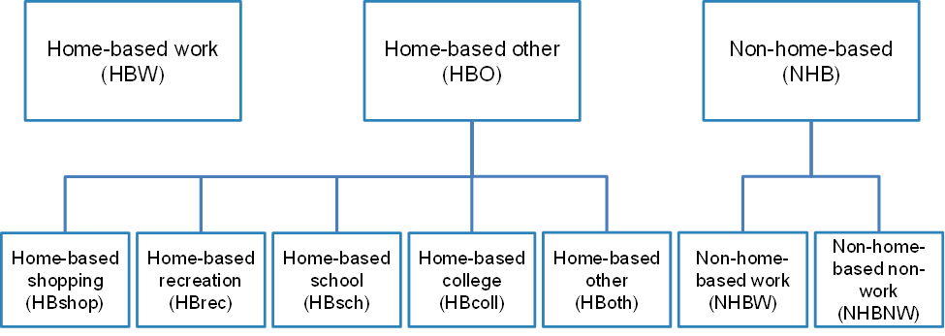
Walk mode split models
II
Traveler characteristics: Household size, income, age, # of workers, # children, # vehicles
Built environment: PIE

Slide 25
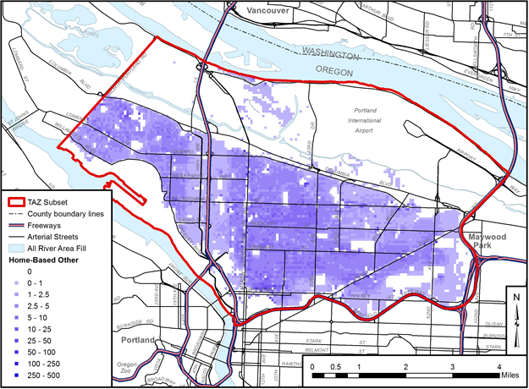
Walk model application

Slide 26

Destination choice
I
Trip Generation (PAZ)
TAZ = transportation analysis zone
PAZ = pedestrian analysis zone
Walk Mode Split (PAZ)
Trip Distribution or Destination Choice (TAZ)
III
Destination Choice (PAZ)
Mode Choice (TAZ)
Pedestrian Trips
Trip Assignment
All Trips
Pedestrian Trips
Vehicular Trips

Slide 27

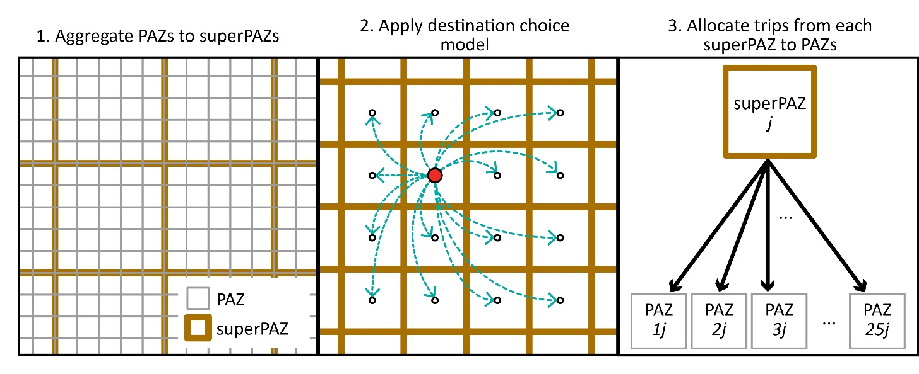
Destination choice

Slide 28
Destination choice
III
Prob(dest.) = function of…
  network distance
  size / # of destinations
  pedestrian environment
  traveler characteristics
Data: 2011 OHAS
Method: multinomial logit model
Spatial unit: super-pedestrian analysis zone
Six trip types: home-based: non-home-based:
work (HBW) work (NHBW)
shopping (HBS) non-work (NHBNW)
recreation (HBR)
other (HBO)
Destination Choice (PAZ)
Pedestrian Trips

Slide 29
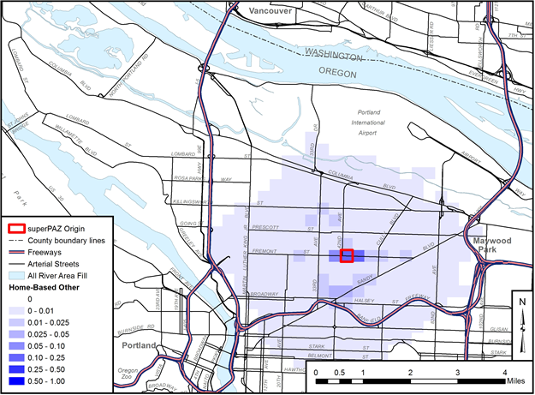
Destination Choice

Slide 30
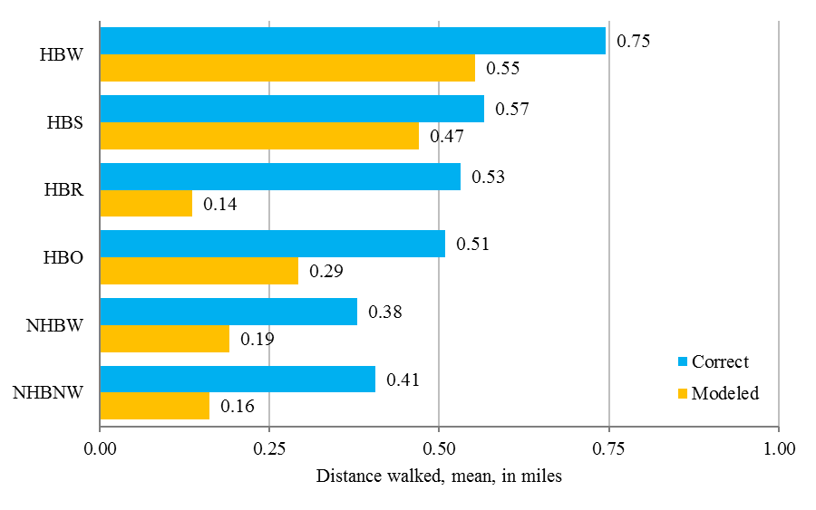
Destination Choice
Model Validation – Avg. Distance Walked

Slide 31
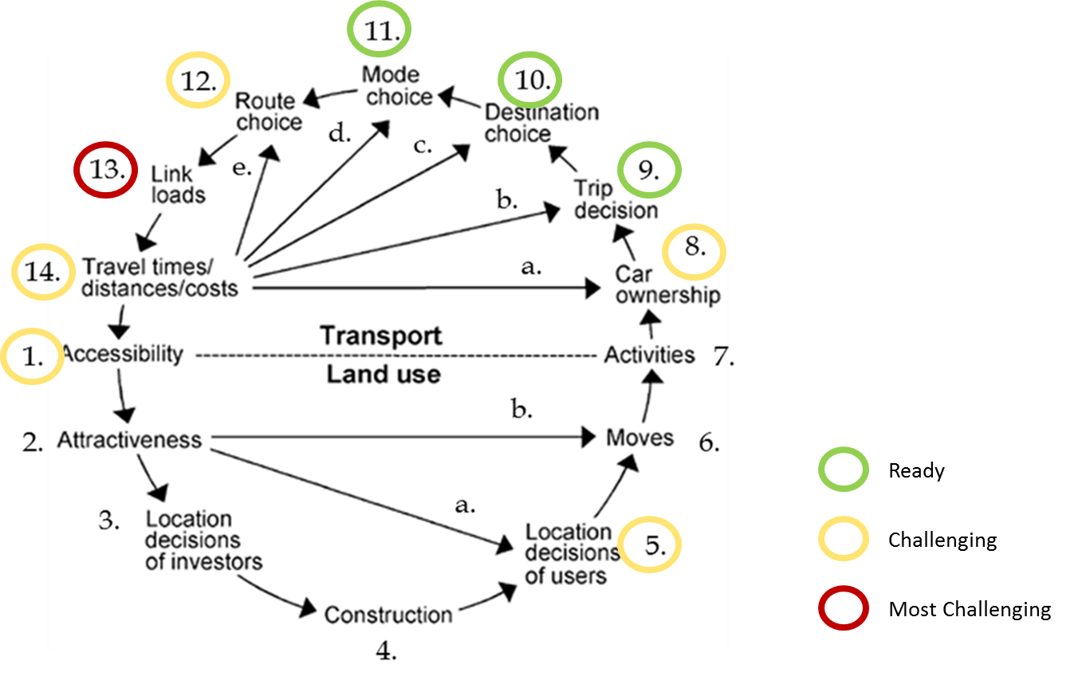
Opportunities & challenges
Behavioral research/data/methods
Adapted from: Wegener and Fürst, 1999

Slide 32










Behavioral research
Decision sequencing:
  activity, mode, destination;
  mode, destination, activity;
  destination, activity, mode
Destination choice considerations
  choice set generation
Willingness to walk
Path/route choice considerations

Slide 33





Behavioral Research
Built environment
  Thresholds & nonlinearities
  Mixing
  Scale
Lifestyle questions:
  Vehicle ownership & residential location
  Attitudes, motivations & values
Positive Utility of Travel
  What aspects?
  Diminishing returns?
Mode feedbacks to trip generation

Slide 34
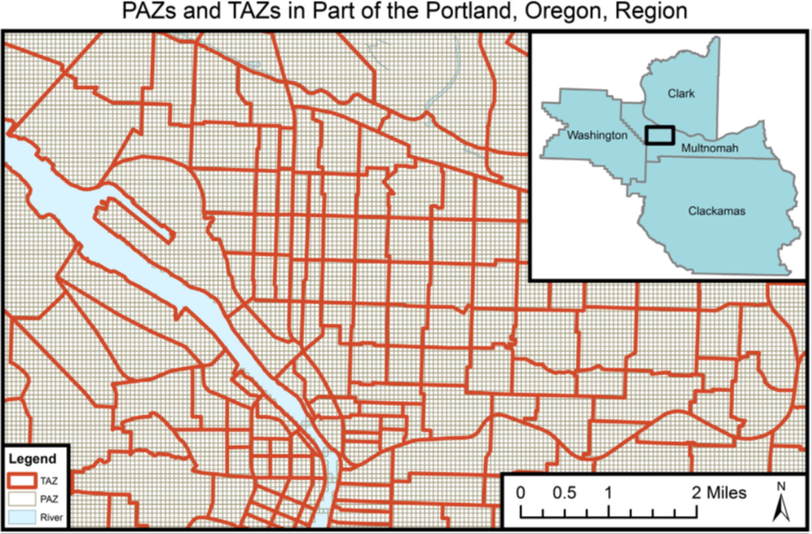
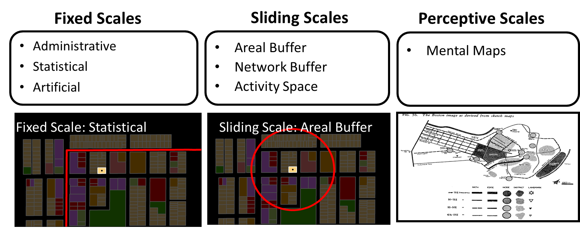
Spatial/Temporal Scale
Depends on output needed for policy/research
Capture variations in the pedestrian built & natural environment
Spatial accuracy
Theory/Behavior

Slide 35
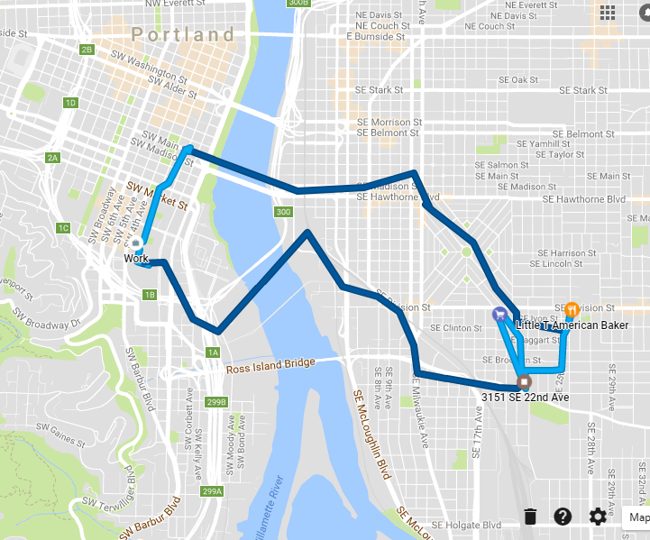
Walking Behavior
Passive data sources
  Trip-level information
  Multi-day
  Multi-modal
  Destinations
  Routes & speeds
But also need…
  Motivations & considerations
  Barriers
  Trips not made

Slide 36
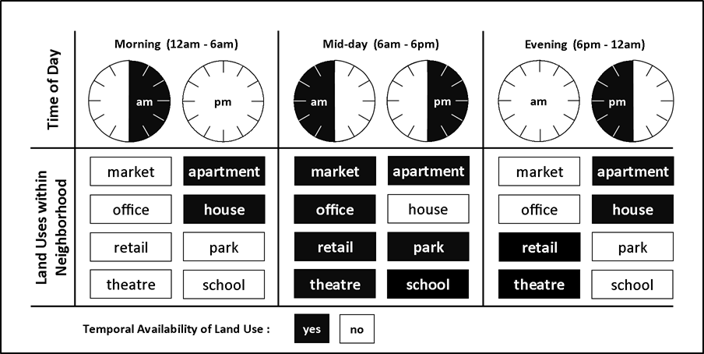
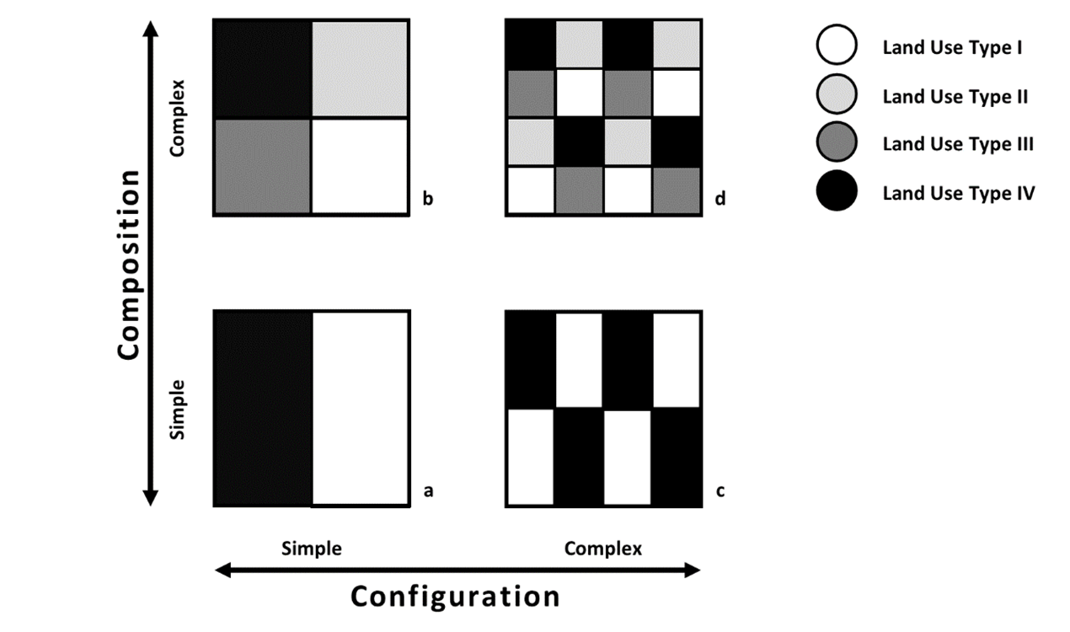
Built environment
How & what to represent?
Indices, proxies
Forecasting
S.R. Gehrke, & K.J. Clifton. (2016). Toward a spatial-temporal measure of land-use mix. Journal of Transport and Land Use, 9(1):171–186
S.R. Gehrke, & K.J. Clifton. (2014). Operationalizing land use diversity at varying geographic scales and its connection to mode choice: Evidence from Portland, Oregon. Transportation Research Record: Journal of the Transportation Research Board 2453: 128-136.

Slide 37
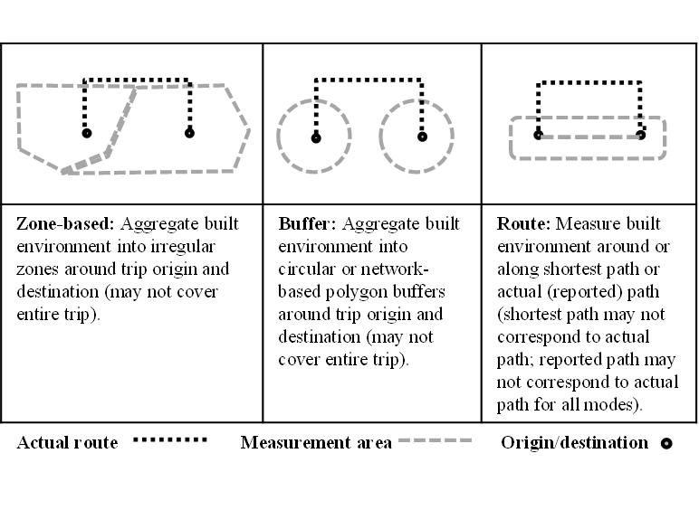
Networks
Network representation
How do we attribute networks?
Feedbacks of travel costs
Do we need to assign trips to a network?
Broach, J. P. (2016). Travel mode choice framework incorporating realistic bike and walk routes (Order No. 10061477). Available from Dissertations & Theses @ Portland State University; ProQuest Dissertations & Theses Global.

Slide 38
Link to Health Outcomes
Health impact analysis
Total time spent walking + speeds
Physical activity budgets
Crash risk exposure
Pollutant exposure
Feedback into life expectancy
Woodcock J, Givoni M, Morgan AS. Health Impact Modelling of Active Travel Visions for England and Wales Using an Integrated Transport and Health Impact Modelling Tool (ITHIM). Barengo NC, ed. PLoS ONE. 2013;8(1):e51462

Slide 39
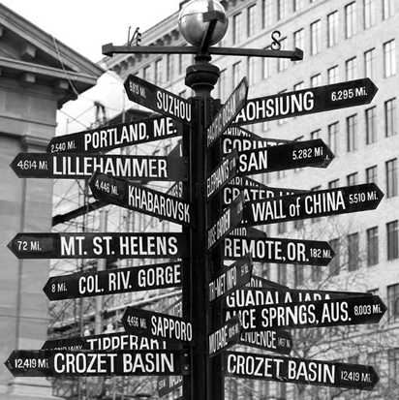
Future directions
Pedestrian Environment
  Policy Sensitivity & Forecasting
Integration with ABM
Trip Generation
  Multinomial Logit model
Pedestrian mode choice
  Feedbacks to trip generation & destination choice
  Better representation of attributes of other modes
Destination Choice
  Explore non-linear effects & other interactions
Route choices or potential pathways
  Need fundamental research to improve understanding

Slide 40
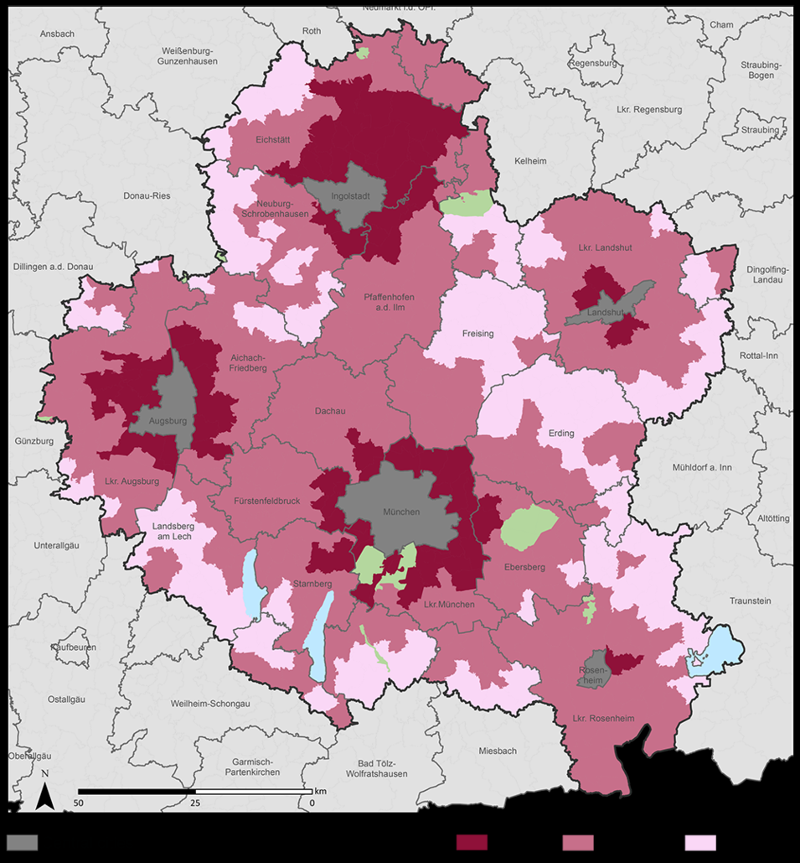
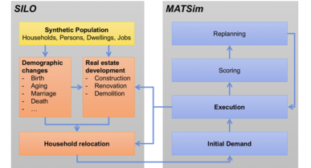
Future directions
Fellowship at Technical University of Munich
Collaborate with Dr. Rolf Moeckel
Incorporate pedestrians into regional integrated land use – transport model
Link to health assessment models
Recruiting funded PhD student (now!)

Slide 41
Questions?
Kelly J. Clifton
kclifton@pdx.edu http://kellyjclifton.com
Project info & reports:
http://trec.pdx.edu/research/project/510
http://trec.pdx.edu/research/project/677
Singleton, P. A., Schneider, R. J., Muhs, C. D., & Clifton, K. J. (2014). “The Pedestrian Index of the Environment (PIE): Representing the Walking Environment in Planning Applications,” Proceedings of the 93rd Annual Meeting of the Transportation Research Board, 2014.
Clifton, K. J., Singleton, P. A., Muhs, C. D., & Schneider, R. J. 2016. “Representing pedestrian activity in travel demand models: Framework and applications”, Journal of Transport Geography, Vol. 52:111-122. http://dx.doi.org/10.1016/j.jtrangeo.2016.03.009.
Clifton, K. J., Singleton, P. A., Muhs, C. D., & Schneider, R. J. 2016. “Development of destination choice models for pedestrian travel”, Transportation Research Part A, 94: 255-265

